Slide 1



Mobile Application Development
Internet programming

Slide 2
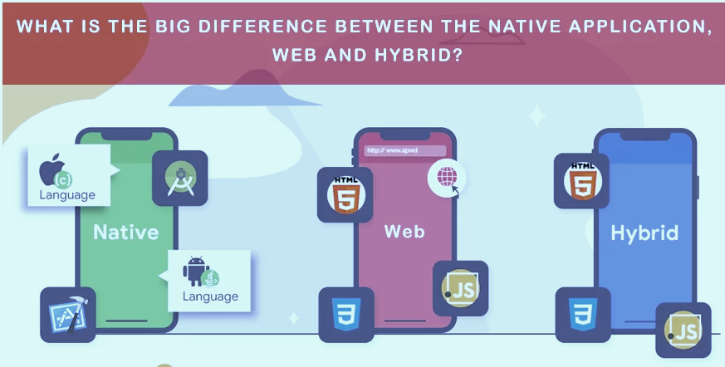
Mobile Application Development
Mobile application development is the set of processes and procedures involved in writing software for small, wireless computing devices, such as smartphones and other hand-held devices.

Slide 3


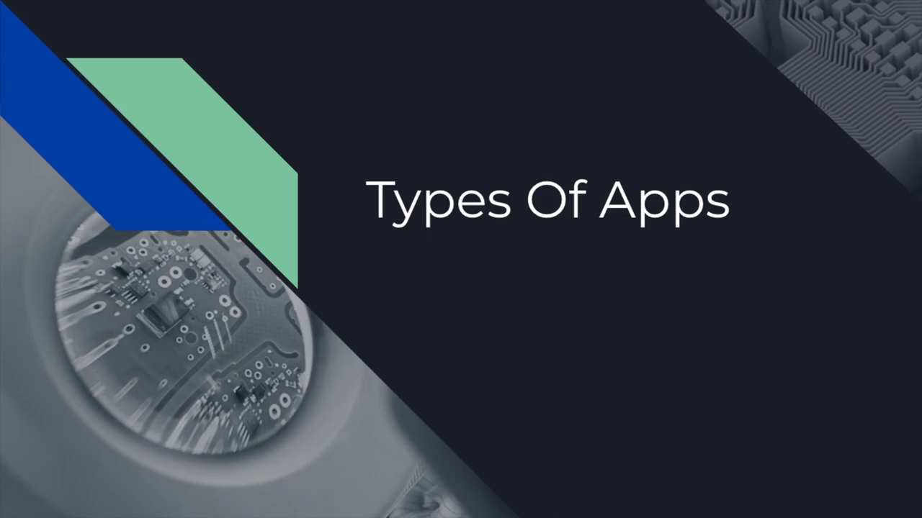
Mobile Application Types
Native Mobile Application
Hybrid Mobile Applications
Web Mobile Applications

Slide 4
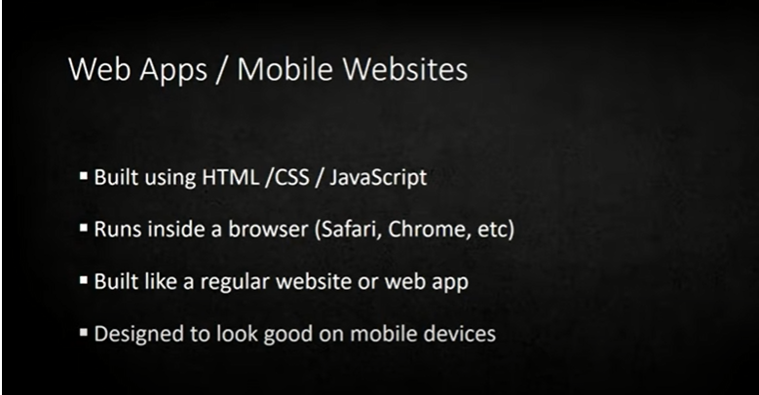
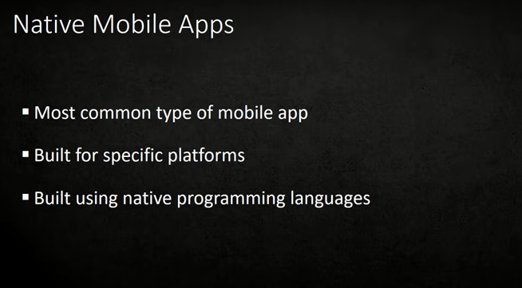
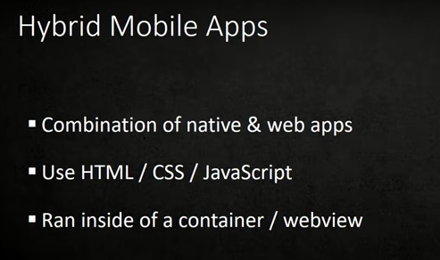
Mobile application Development Types Native, Web and Hybrid. Let us understanding the differences.
Looking at how each technology affects the other and where each technology gains grounds as the other falls

Slide 5
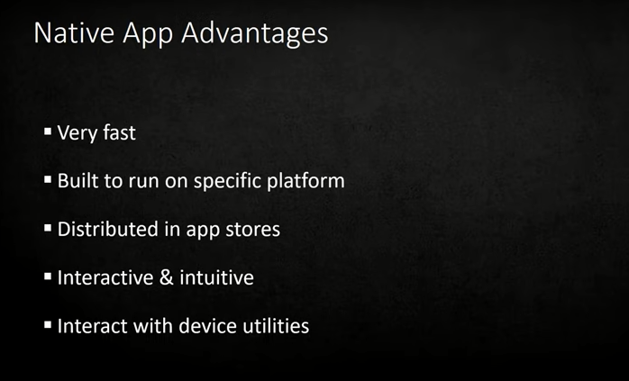
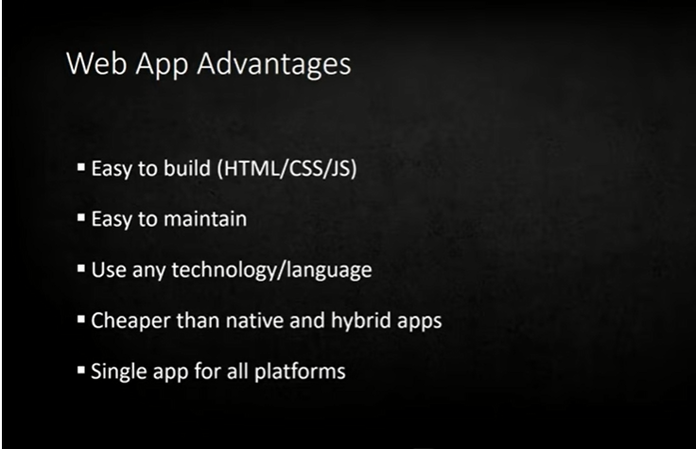
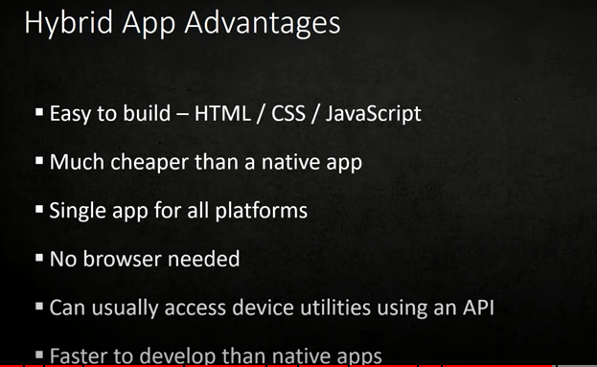
Mobile application Development Types Native, Web and Hybrid. Let us understanding the differences.
Looking at the Advantages of this applications types as per their characteristics.

Slide 6
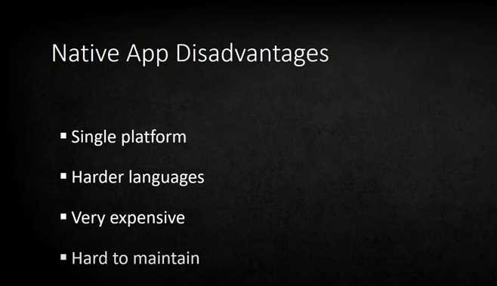
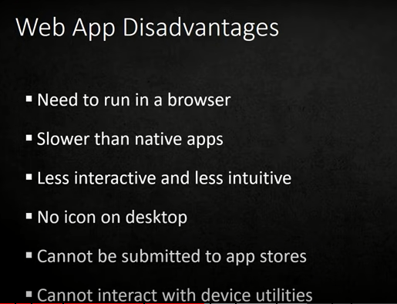
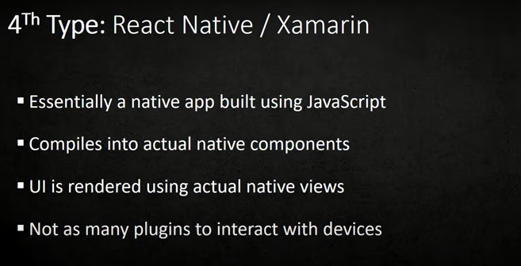
Mobile application Development Types Native, Web and Hybrid. Let us understanding the differences.
Looking at the disadvantages of this applications types as per their characteristics.

Slide 7
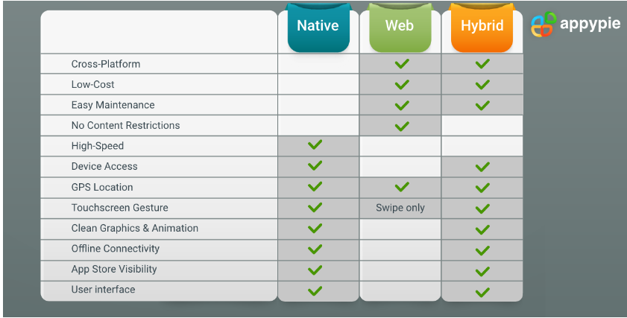
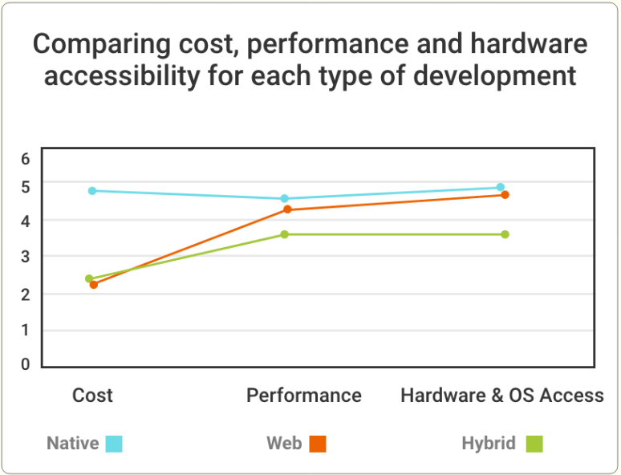
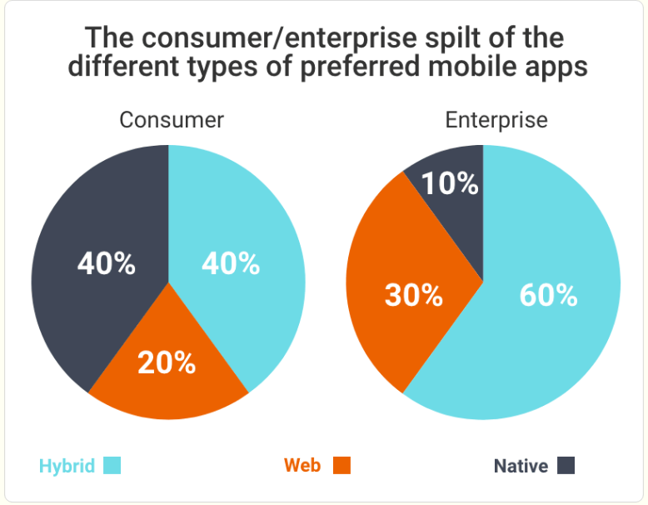
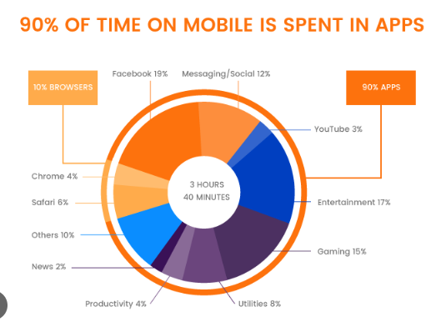
Statistical evolution
Statistically comparing of the vireos mobile application types in terms of special characteristics, like usage, speed, cost, cross platform ability, and more gives us a senses of better decision making.

Slide 8
Mobile application Programming languages
Here let us look at one of the most popular programming languages used in mobile application development.
Web Apps
JavaScript
React
Express
java
React Native
Ruby on rails
java
Ruby
SQL
TypeScript
Python
Angular
PHP
Hybrid Apps
HTML5, CSS3
C#
React
Dart
JavaScript
Python
Ruby
Native Apps
Swift
Java
Objective C
C++
C#
Python
JavaScript

Slide 9
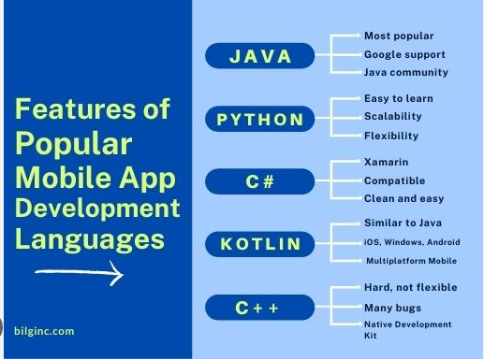
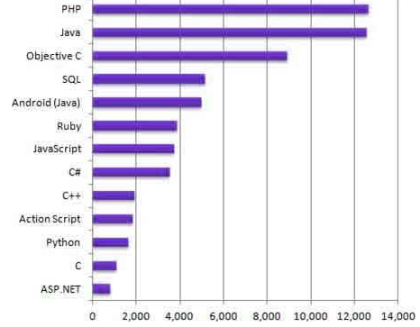
Mobile application Programming languages
Chart showing programming languages and attached framework
Here is the trending of languages used in mobile application development. We can make conclusions based on the statistics bellow .

Slide 10
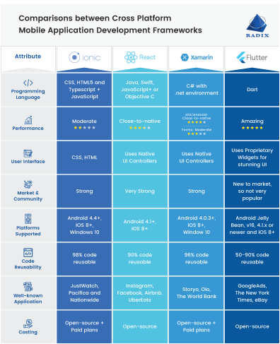
Mobile application Development framework
Here are a list of trending frameworks used in mobile application development.
Looking at does statistics we can make decisions on what languages to use.

Slide 11
Collection and Analysis for the development requirement for mobile applications
Here we will look at the requirements in terms of functional and non functional requirement.
The role of the business analyst is to comprehensively compile the various requirements into a Software Requirements
Functional requirements describe how software (e.g., mobile or web application) should behave. They also define the properties or attributes of a given system.
The purpose of the Functional Requirements analysis is primarily the need to understand and define the requirements placed on the software by the various stakeholders.
It is worth remembering that Functional Requirements are not autonomous and are interdependent with quality expectations, goals, and business rules.
In addition, as a result of analyzing Functional Requirements, we should rank individual functionalities, determine their importance, and link them to specific software elements.
Requirements validation aims to verify that the collected requirements are complete and free of errors.
It should also provide an answer to whether the collected information allows you to start working and create a digital product that can achieve your business goals and align with the expectations of its users.

Slide 12
Collection and Analysis for the development requirement for mobile applications
Here we will look at the requirements in terms of functional and non functional requirement.
The role of the business analyst is to comprehensively compile the various requirements into a Software Requirements
Non-functional requirements or NFRs are a set of specifications that describe the system’s operation capabilities and constraints and attempt to improve its functionality. These are basically the requirements that outline how well it will operate including things like speed, security, reliability, data integrity, etc. nonfunctional r
Performance and scalability. How fast does the system return results? How much will this performance change with higher workloads?
Portability and compatibility. Which hardware, operating systems, and browsers, along with their versions does the software run on? Does it conflict with other applications and processes within these environments?
Reliability, maintainability, availability. How often does the system experience critical failures? How much time does it take to fix the issue when it arises? And how is user availability time compared to downtime?
Security. How well are the system and its data protected against attacks?
Localization. Is the system compatible with local specifics?
Usability. How easy is it for a customer to use the system?

Slide 13
Cost of Development
The price of developing an app depends upon what type of app you’re building. Generally, the average rate of building an app ranges from $40,000 to $150,000, depending upon the complexity of the app.
If you are considering developing an app, it is important to understand all the factors that can affect the cost. Some factors influencing the app development cost are:
Size of app
Features and functionality
The complexity of visual design*
Android or iOS
Hiring a freelance developer or a software development agency**
Backend infrastructure*
Size of App
The cost of developing an app can be affected by the size of the app: small, medium or large Apps. Small Apps have standard user interface elements, are designed for a single platform, have fewer features, no backend coding is required. For medium Apps the UI and payment methods are standard. Larger Apps require many more features, support multi-language, extensive backend development to store and manage massive databases and much more e.g an Uber.

Slide 14
Cost of Development
Features and functionalities
The features and functionalities of an App contribute greatly to the cost of the App development. Building an App with fewer features takes a lesser amount of time hence the cost of development will be less. On the other hand complex features in an App requires more time leading to a higher App development cost. These functionalities includes whether the App should be multi-languaged, should contain user-login(via email, via text or via social media account) or not(no login required), the type of customer support you require (such as realtime chats where agents will answer questions of the users in realtime or contact form where users will fill a form to get in contact with the support services) or no customer support, whether users can communicate in the App, the presence of a chat(1-1 messaging, Group chat and file sharing between users), the type of gratification features (such as “Like system” or “Rating system”) or none, the type of security(standard with security featured such as authorization, confirmation, email or advanced security).
Android or iOS
Android is a mobile operating system used in Blackberry, Samsung, HTC. IOS is a mobile operating system used in iphones. iOS running Apps are less expensive then Android running Apps because the scope for device fragmentation is much wider for Android than ios Apps. IOS comes with about 20 different types of devices while hundreds of different mobile devices are supported by Android so building an Android App will require you to adapt it to different fragmentations making Android App development cost a bit higher. Also Android emulators perform much slower than ios simulators so much amount of time is spent on Android App testing for all the different versions of an Android leading to more development hours hence making the development cost a bit higher.

Slide 15
Cost of Development
Dev Cost | Push Notifications | Ratings & Reviews | Native Integration | Web Portal | Performance Management
>$5,000 | 70% | 71% | 40% | 29% | 61%
$$5,000-$10,000 | 15% | 12% | 28% | 26% | 18%
$10,000-$15,000 | 7% | 12% | 11% | 16% | 5%
$15,000-$25,000 | 6% | 5% | 10% | 11% | 13%
$25,000-$50,000 | 0% | 0% | 7% | 6% | 1%
$50,000-$100,000 | 1% | 0% | 1% | 9% | 0%
$100,000+ | 0% | 0% | 3% | 3% | 0%

